Slide 1
CS3391Object Oriented Programming
Dr.D.Sivaganesan, Professor,
PSGiTech / CSE

Slide 2
Methods in Java
Method is defined as the named collections of statements
Syntax:
return type method name (parameter-list)
{
body of method
return value // if other than void type
}
return type specifies the type of data returned by the method. This can be any valid type,
If the method does not return a value, its return type must be void.
The name of the method is specified by name.
The parameter-list is a sequence of type and identifier pairs separated by commas.
Methods that have a return type other than void return a value to the calling routine using the
following form of the return statement:
Syntax:
return value;

Slide 3
class Box Method without parameters
{
int width,height,depth;
//display volume of a box
void volume() {
System.out.print("Volume is ");
System.out.println(width * height * depth);
}}
class exmethod {
public static void main(String args[])
{
Box mybox1 = new Box();
//assign values to mybox1's instance variables
mybox1.width = 10; mybox1.height = 20; mybox1.depth = 15;
//display volume of first box
mybox1.volume();
}}

Slide 4
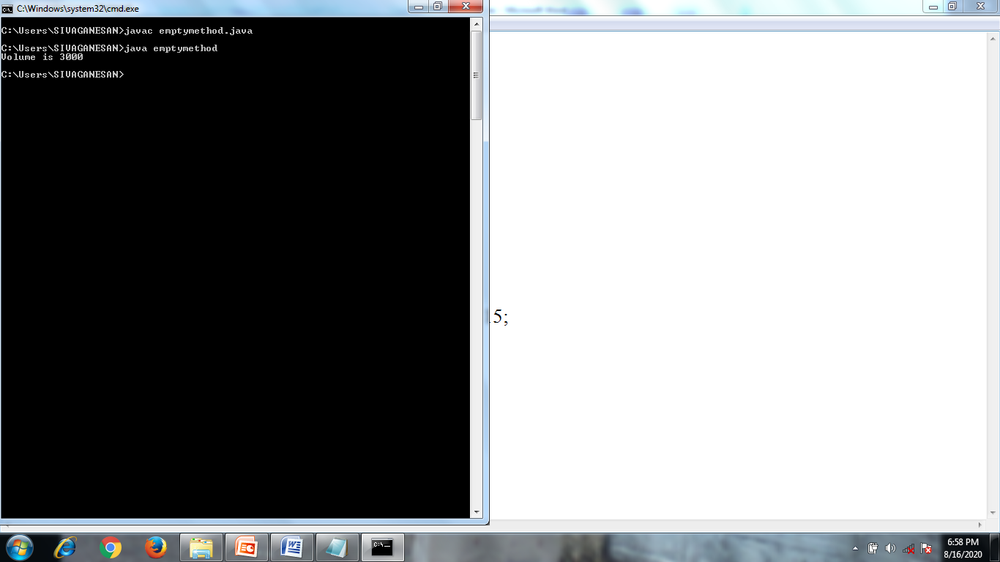

Slide 5
Method with parameters
class Box
{
int width; int height; int depth;
//display volume of a box
void volume(int a,int b,int c) {
Width=a;height=b;depth=c;
System.out.print("Volume is ");
System.out.println(width * height * depth);
}}
class exmethod {
public static void main(String args[])
{ Box mybox1 = new Box();
//display volume of first box
mybox1.volume(10,20,12);
}}

Slide 6
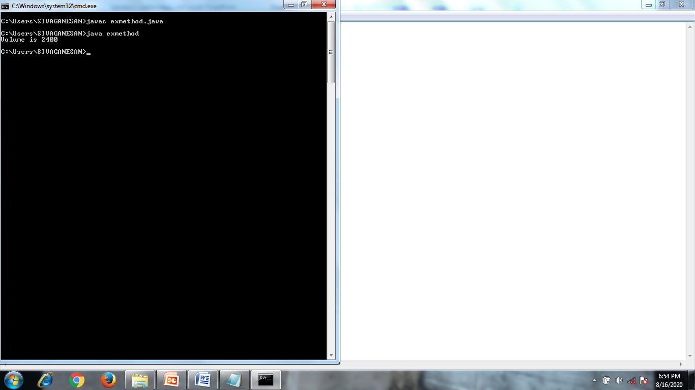

Slide 7
class Box Method with returning value
{
int width; int height; int depth;
//display volume of a box
int volume() {
return (width * height * depth);
}}
class exreturn{
public static void main(String args[])
{
Box mybox1 = new Box();
int vol;
//assign values to mybox1's instance variables
mybox1.width = 10; mybox1.height = 20; mybox1.depth = 15;
//display volume of first box
vol= mybox1.volume();
System.out.print("Volume is “+vol);
}}

Slide 8
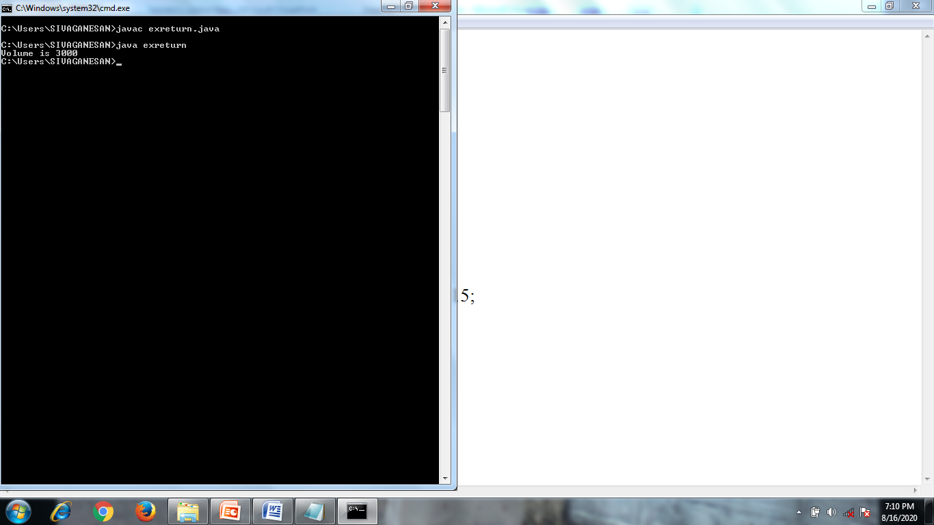

Slide 9
Overloading Methods - Polymorphism
When two or more methods within the same class that have the same name, but their parameter declarations are different.
The methods are said to be overloaded, and the process is referred to as method overloading.
Method overloading is one of the ways that Java supports polymorphism.
There are two ways to overload the method in java
By changing number of arguments
By changing the data type

Slide 10
//Demonstrate method overloading.
class OverloadDemo {
void test() {
System.out.println("No parameters");
}
// Overload test for one integer parameter.
void test(int a) { System.out.println("a: " + a); }
// Overload test for two integer parameters.
void test(int a, int b) { System.out.println("a and b: " + a + " " + b); }
//Overload test for a float parameter
float test(float g)
{ float c= g*g;return c;}}
class exoverload {
public static void main(String args[]) {
OverloadDemo ob = new OverloadDemo();
double result;
// call all versions of test()
ob.test();
ob.test(10);
ob.test(10, 20);
result = ob.test(123.25f);
System.out.println("Result of ob.test(123.25): " + result);
} }

Slide 11
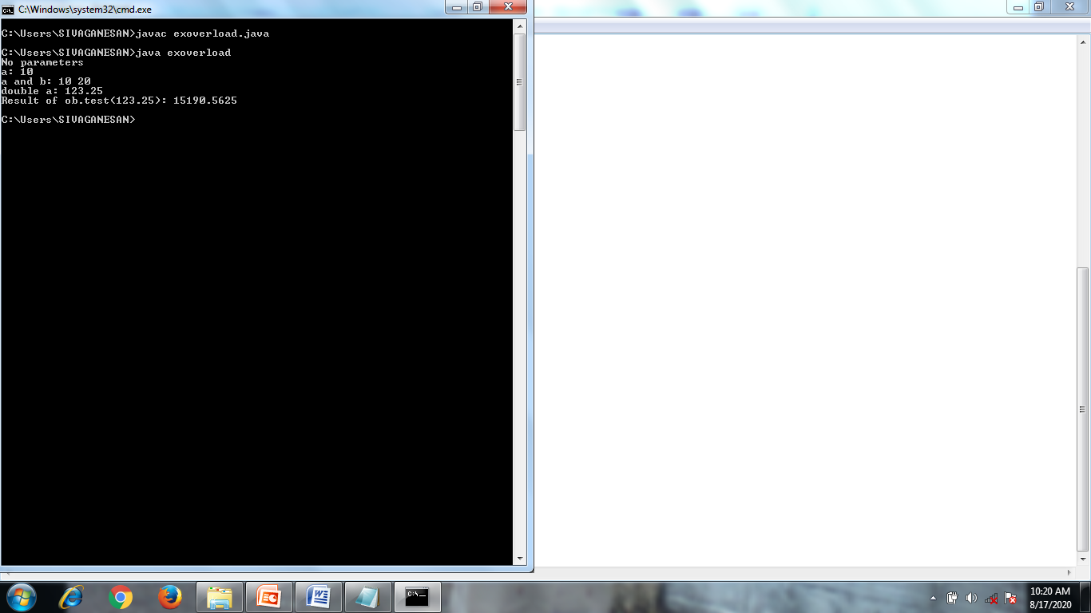

Slide 12
Constructors
Constructors are special member functions whose task is to
initialize the objects of its class.
It is a special member function, it has the same as the class
name.
Java constructors are invoked when their objects are
created
Every class has a constructor when we don't explicitly declare
a constructor for any java class the compiler creates a
default constructor for that class which does not have any
return type.
The constructor in Java cannot be abstract, static, final or
synchronized and these modifiers are not allowed for the
constructor.
Default constructor (no-arg constructor)
Parameterized constructor – method overloading

Slide 13
Default constructor (no-arg constructor)
A constructor having no parameter is known as default constructor and no-arg constructor.
/* Here, Box uses a constructor to initialize the dimensions of a box. */
class Box {
int width,height,depth;
//This is the constructor for Box.
Box()
{
System.out.println("Constructing Box");
width = 10; height = 10; depth = 10;
}
int volume() {
return width * height * depth;
} }
class excons{
public static void main(String args[]) {
// declare, allocate, and initialize Box objects
Box mybox1 = new Box();
int vol;
//get volume of first box
vol = mybox1.volume(); System.out.println("Volume is " + vol);
}}

Slide 14


Slide 15
Parameterized Constructors
A constructor which has a specific number of parameters is
called parameterized constructor.
Parameterized constructor is used to provide different values to
the distinct objects.
Syntax:
constructor name( data type v1, v2…)
{
instance var1 = v1;
instance var2= v2;
.
.
.
}

Slide 16
class rect {
float width,height;
//This is the constructor with arguments
rect(float w,float h)
{
width = w; height = h;
}
float area() {
return width * height;
} }
class exparacons{
public static void main(String args[]) {
// declare, allocate, and initialize rect objects
rect r1 = new rect(10.2f,8.3f);
float a;
a = r1.area(); System.out.println(“Area of rect is " +a);
}}

Slide 17


Slide 18
Overloading Constructors
class room {
float width,height;
//This is the constructor with arguments
room(float w, float h)
{ width = w; height = h; }
room(float v)
{ width = height = v; }
float area() {
return width * height; } }
class overcons{
public static void main(String args[]) {
// declare, allocate, and initialize rect objects
room r1 = new room(10.5f,12.3f);
room r2 = new room(12.5f);
float a;
a = r1.area(); System.out.println(“Area of rect is r1" +a);
a = r2.area(); System.out.println(“Area of rect is r2" +a);
}}

Slide 19


Slide 20
Thank you

